Slide 2

The Iceberg Theory
10%
Visible
(above the water)
Behavior, Practices & Artifacts
Music, Food….(observable to the 5 senses)
Strategic communications is looking below the water line
Relationships
Culture Behaviors Pride Bias Practices History
Norms and rules Personal Experiences World view and Basic Assumptions
Opinions Viewpoints Attitudes Values Convictions Beliefs
90%
Not Visible
(below the water)
Iceberg Theory
“Below the line” issues
Huge & invisible.
Purposely hidden, or simply
Out of awareness
90%
Notes:
Iceberg Theory
“Below the line” issues
Huge & invisible.
Purposely hidden, or simply
Out of awareness

Slide 3
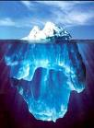
Why is negotiations difficult?
ACTION => VISIBLE LEVEL 10 %
REACTION =>
INVISIBLE LEVEL 90%
Norms and rules
Personal experiences
Values
World view and basic assumptions

Slide 4
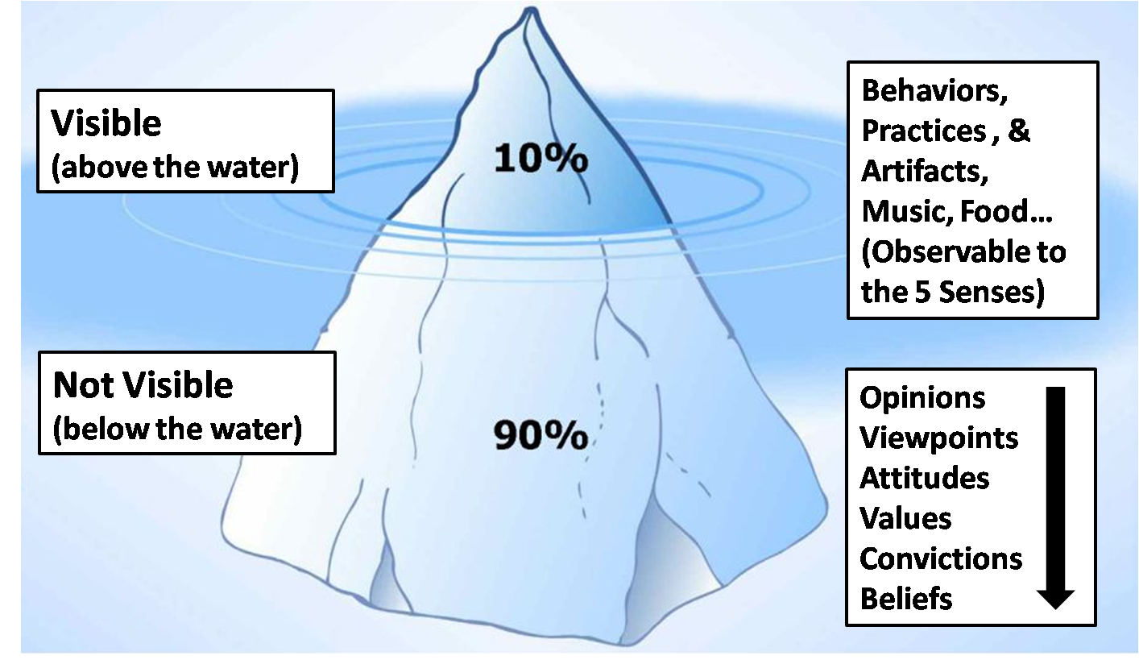
The Cultural Iceberg

Slide 5

THE INTEREST ICEBERG
Remedy Requested
Relationships
Culture
Behaviors
Pride
Bias
Practices
History
Notes:
Explain the centrality of culture in Interest Negotiations
Clarify INTERESTS Not Positions
Ask why?, why not?
Capitalize on joint interests, reconcile differing interests
Look to CRITERIA and creative OPTIONS to deal with conflicting interests
Invent OPTIONS for Mutual Gain
Separate inventing from deciding
Generate options through “brainstorming”
no evaluation, no commitment, no attributions

Slide 6

Strategic communications is looking below the water line
Application

Slide 7



What lies beneath is “gold” for strategic communications
Application
TALKINGPTS
ACHIEVMENT /GUILT
PUNITIVE
JUSTICE
INDIVIDUAL
LOGIC
TRANSACTIONS
BRIDGING TRUST
HONOR/SHAME
RESTORATIVE JUSTICE
EMOTION
CLAN
RELATIONSHIPS
BONDING TRUST
STORY
TRIBAL

Slide 8
What’s beneath your waterline? Group exercise
Application

